Slide 1

SoC
Selen Özge Özgür
Canberk Kaçan
Onat Şimşek

Slide 2
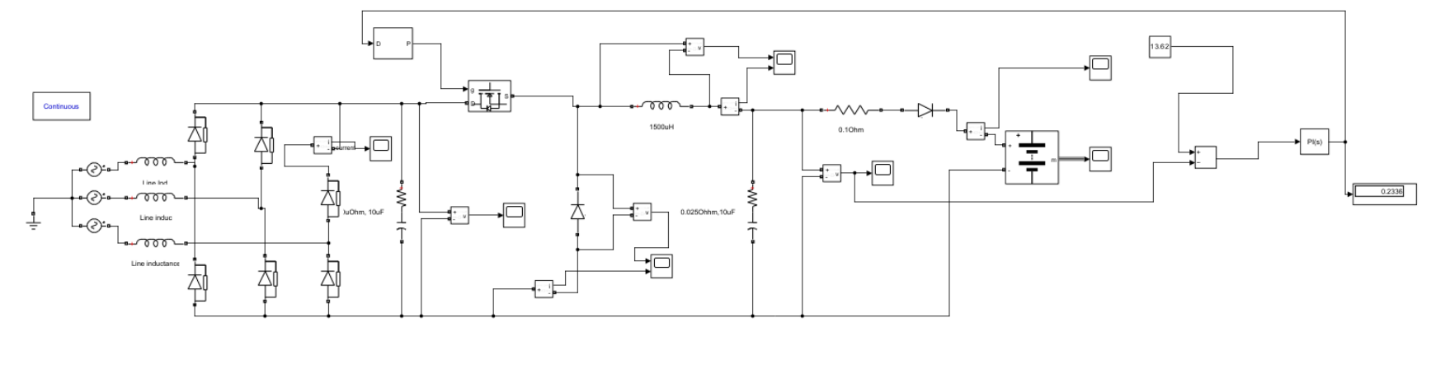
Design Topology

Slide 3
Theoretical Calculations
 | Theoretical Calculation | Simulation Results
Buck Converter Inductance (L) | 80. 64 µ𝐻 (min) | 1500 µ𝐻
Buck Converter Capacitance | 0.83 µF | 10 µF
Three Phase FBDR Capacitance | 8.95 µF | 10 µF

Slide 4
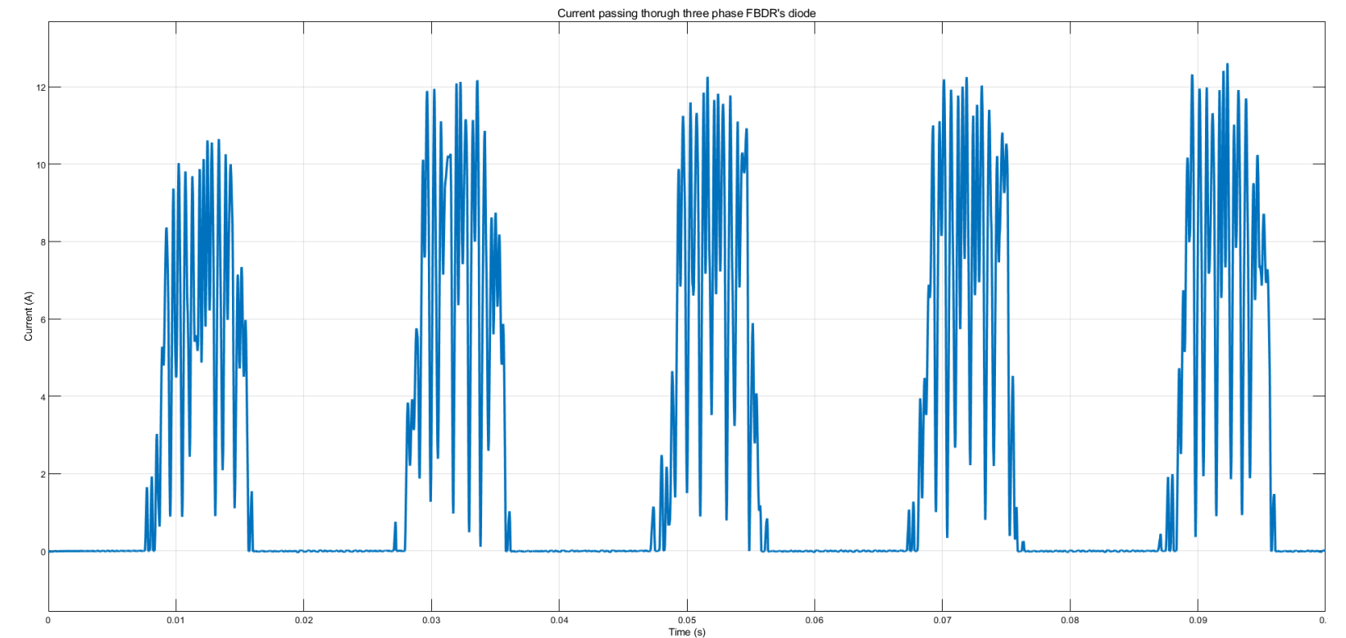
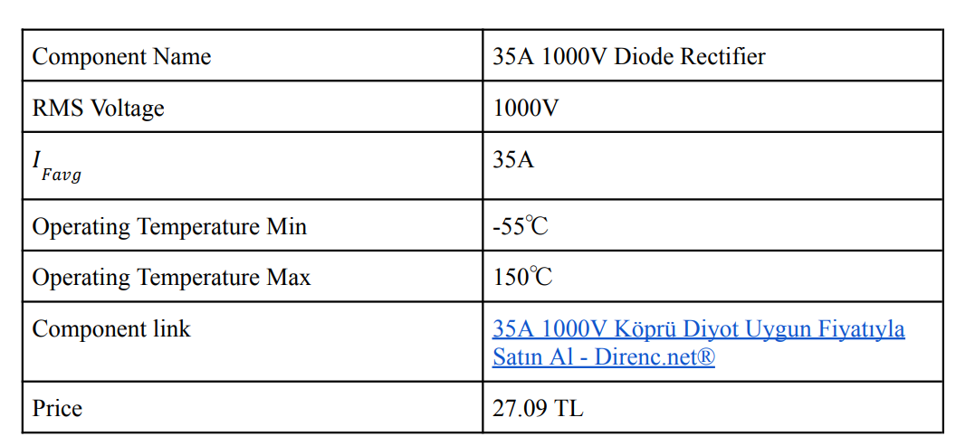
Three Phase FBDR Simulation Results
35A 1000V Köprü Diyot Uygun Fiyatıyla Satın Al - Direnc.net®
Current wavefroms of the three phase FBDR. Maximum current of the rectifier is 12 A.

Slide 5
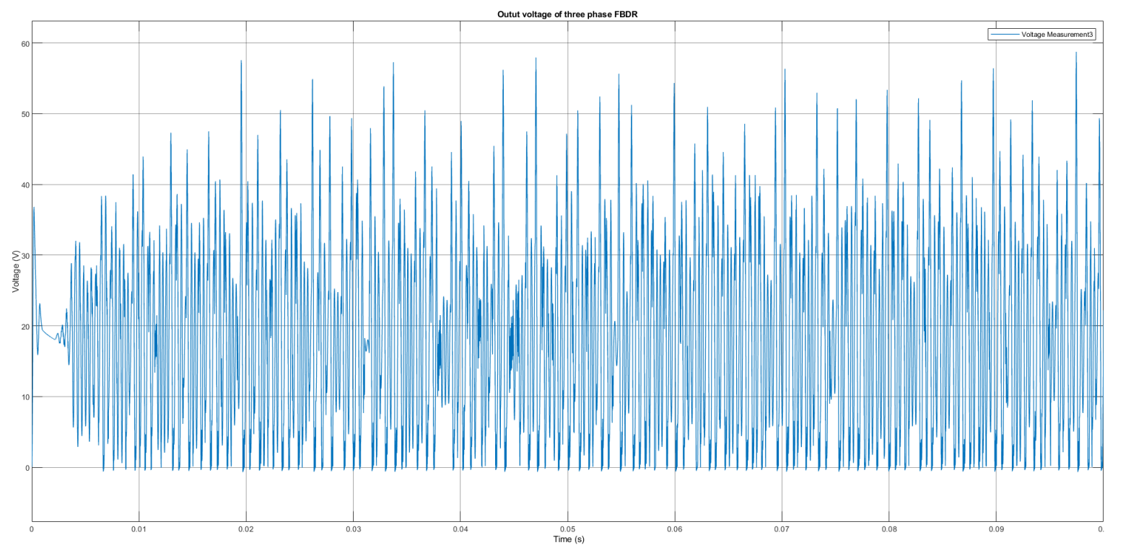
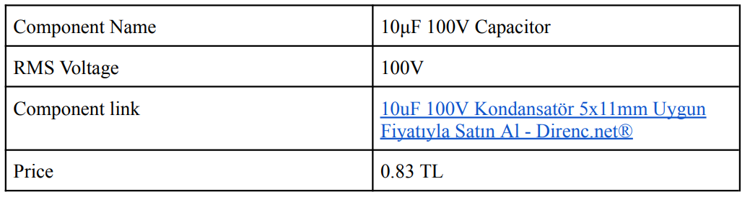
Three Phase FBDR Simulation Results
Output Voltage wavefroms of the three phase FBDR given. Maximum voltage seen by Three phase FBDR is 60V.

Slide 6
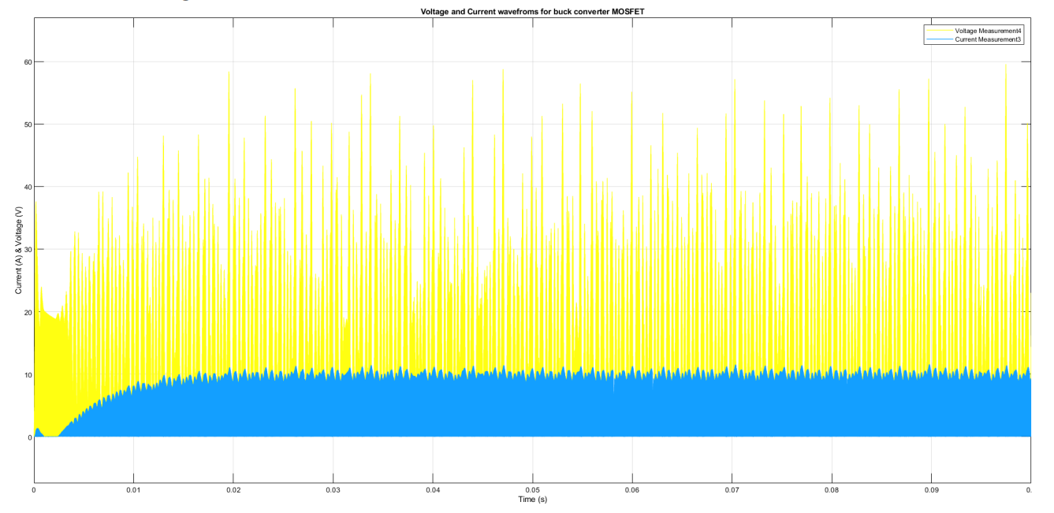
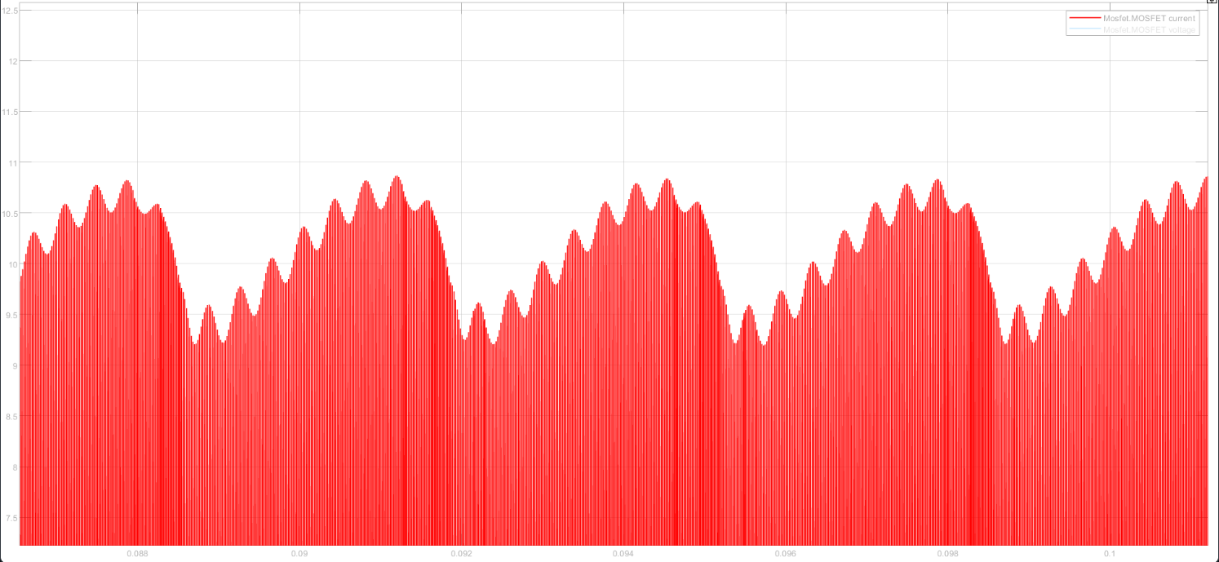
Buck Converter Mosfet Waveforms

Slide 7
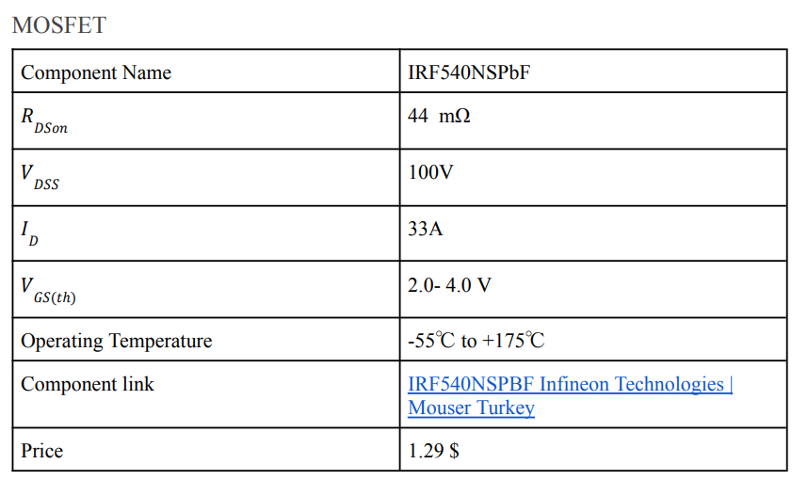
Buck Converter Mosfet Waveforms
Buck Converter MOSFET peak current 11A, peak voltage less than 60V.

Slide 8
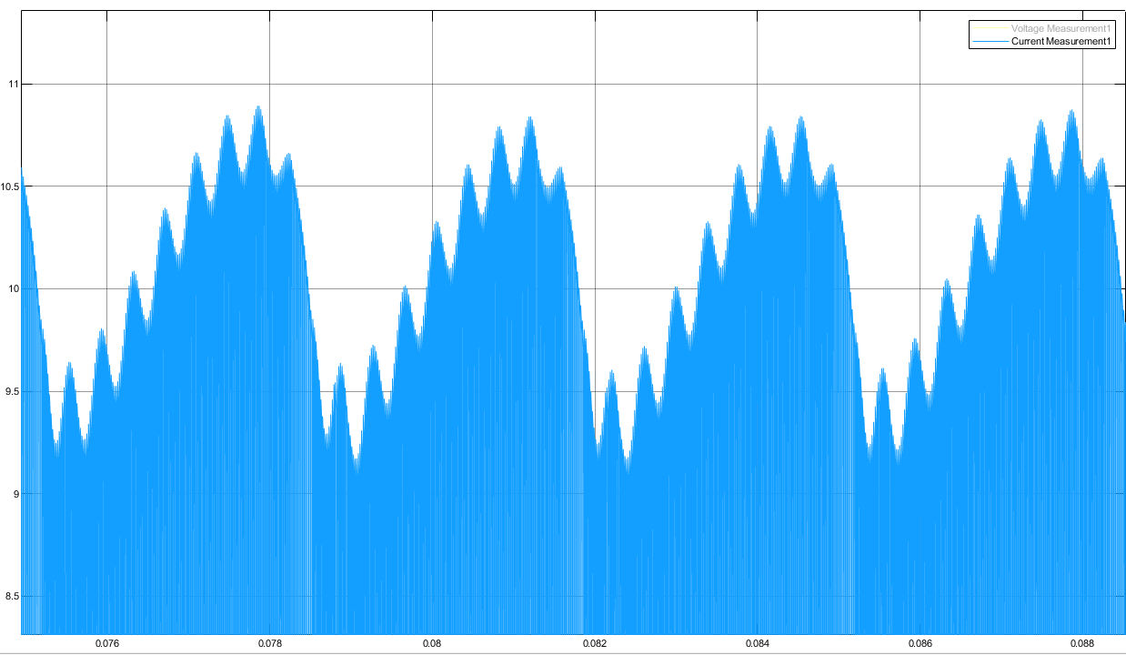
Diode Waveform
Peak = 11A

Slide 9
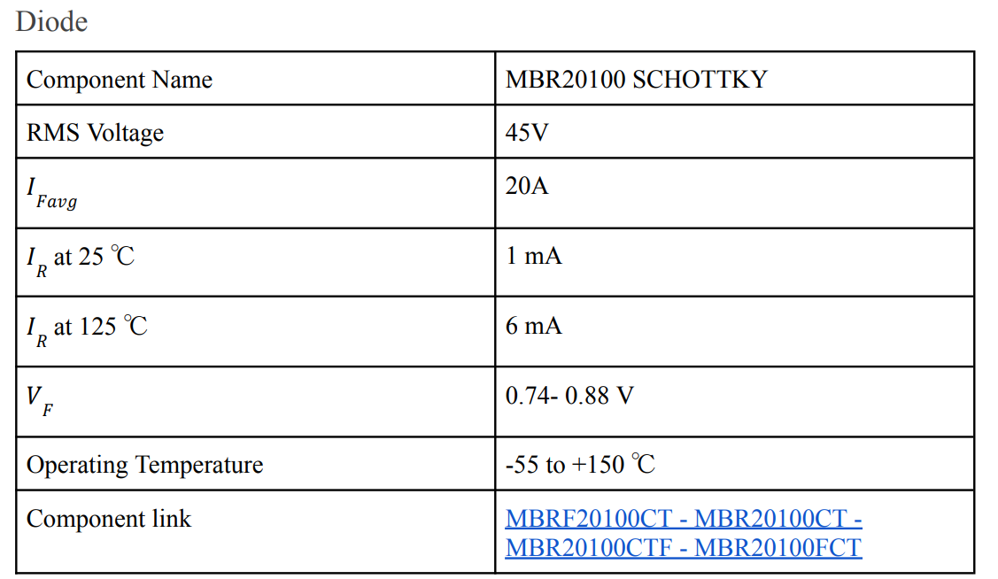
Component Selection
Buck Converter diode peak current 11A, peak voltage less than 63.6V.
https://www.cakirelektronik.com/urun/mbr20100fct-mbr20100-20a-100v-schottky-barrier-rectifier

Slide 10
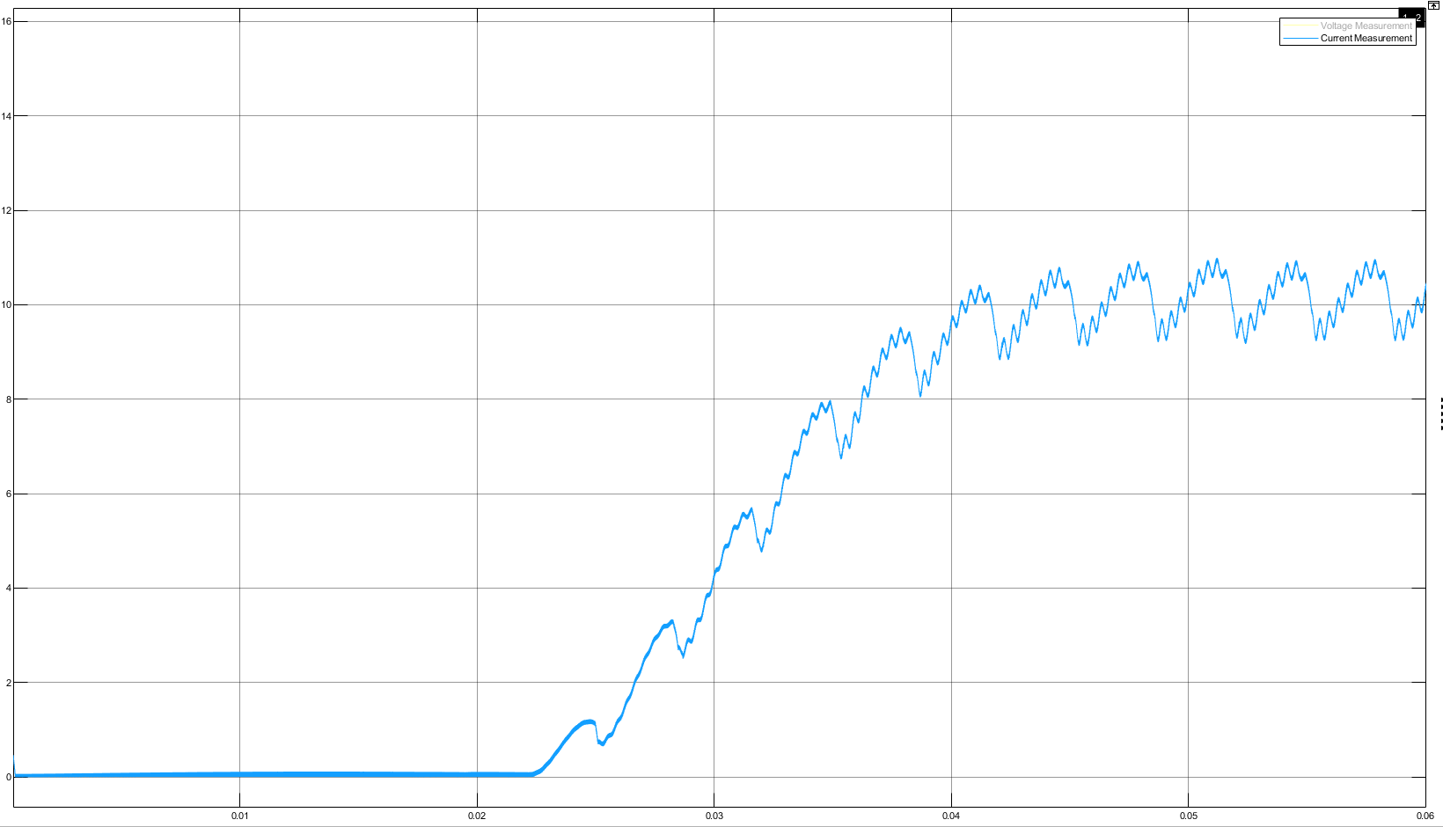
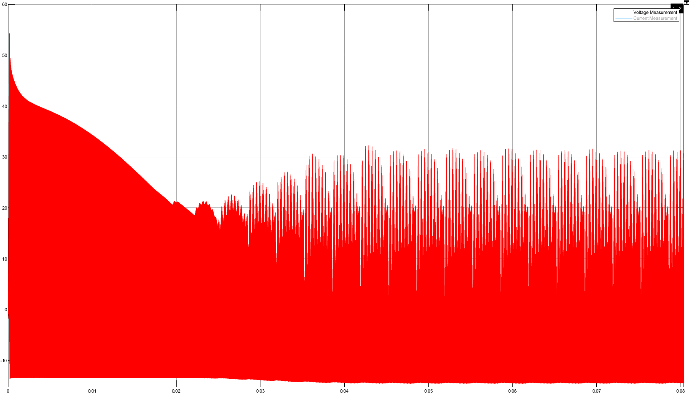
Inductor Waveforms

Slide 11
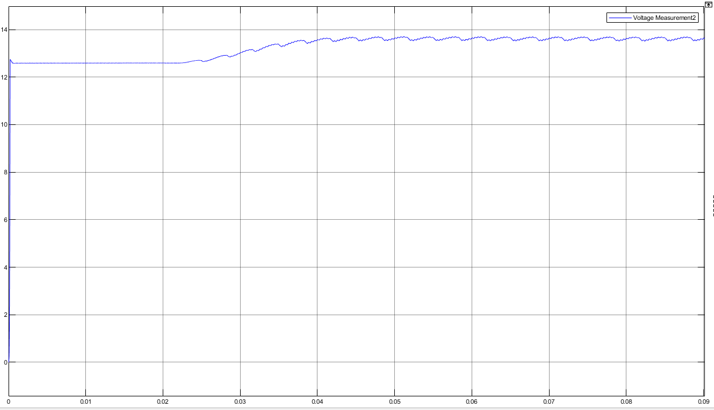
Output Capacitor Waveform

Slide 12
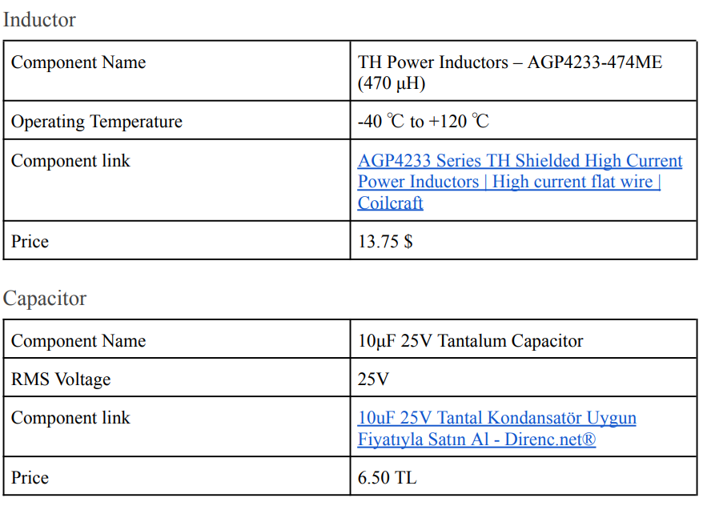
Component Selection
Buck Converter inductor peak current 11A, peak voltage less than 55V.
https://www.coilcraft.com/en-us/products/power/shielded-inductors/high-current-flat-wire/agp-ver/agp4233/#:~:text=AGP4233%20power%20inductors%2C%20along%20with,low%20DC%20and%20AC%20resistance.
https://www.direnc.net/10uf25v-tantal
Buck Converter output capacitor peak voltage less than 13.7V.

Slide 13
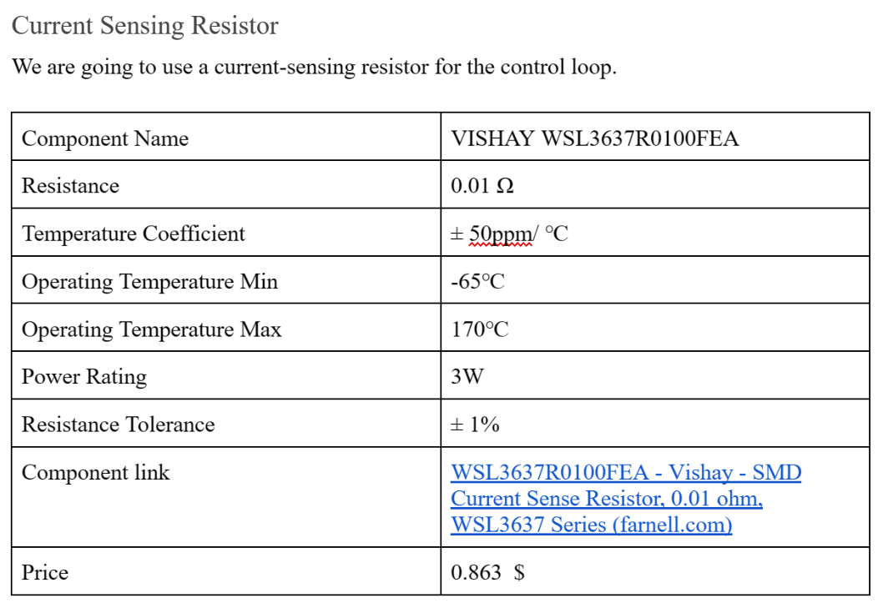
Component Selection
https://tr.farnell.com/vishay/wsl3637r0100fea/current-sense-res-0r01-1-3-w-3637/dp/2395994

Slide 14
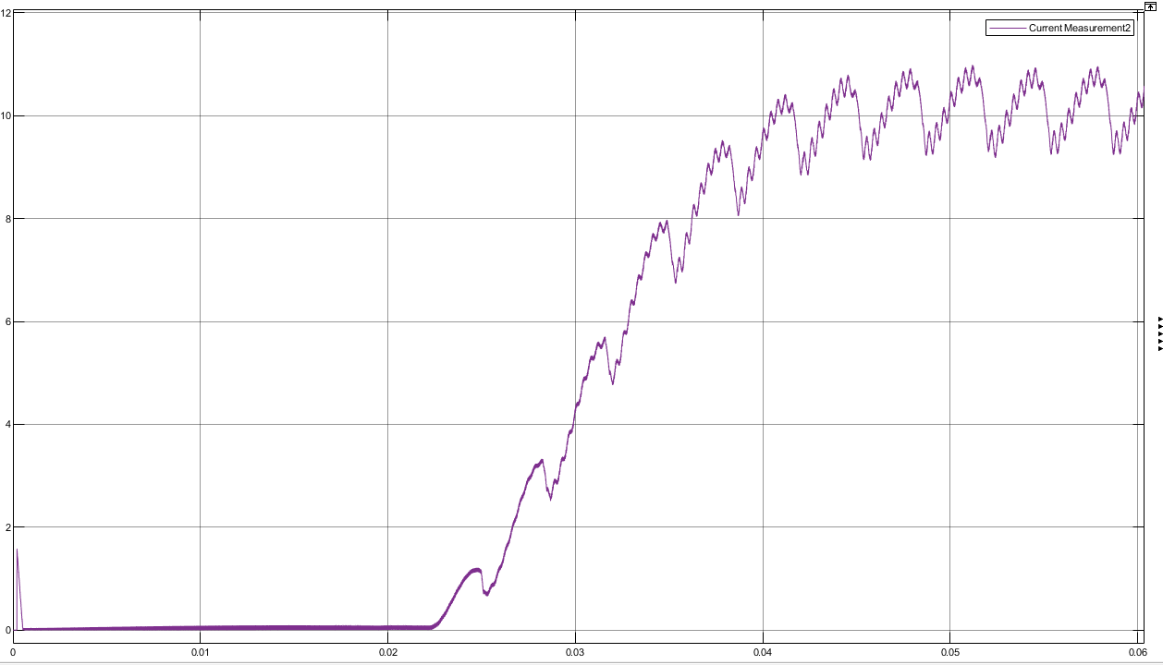
Diode, before the battery

Slide 15
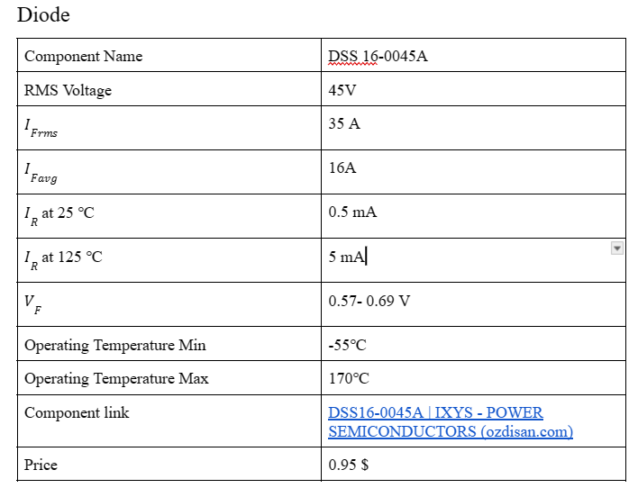
Component Selection
Buck Converter diode, before the battery, peak current 11A.
https://ozdisan.com/guc-yari-iletkenleri/diyotlar-modul-diyotlar-ve-dogrultucular/schottky-diyotlar/DSS16-0045A

Slide 16
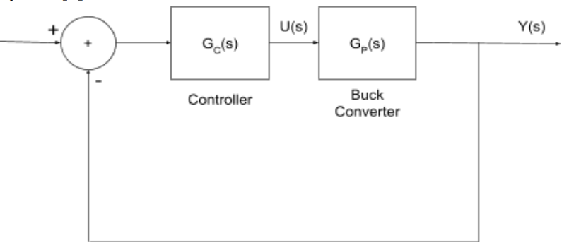
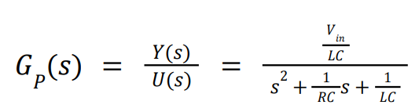
Controller Selection
Transfer Function of the Buck converter is given above.
Y(s): Voltage output of the buck converter
U(s): Duty cycle

Slide 17
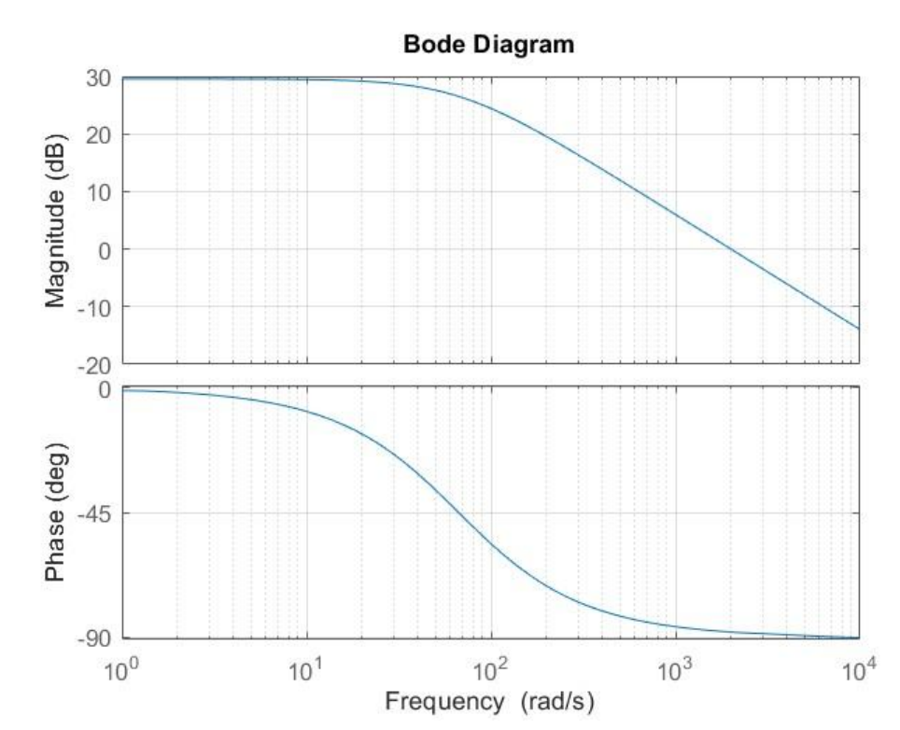
Controller Selection
By using PID tunning:
Kp = 0.068125711694835
Ki = 6.811891811116887
Bode Diagram of the open loop buck converter

Slide 18
Will be added
Fuse (15A) after FBDR (before MOSFET) for currrent protection
Analog or Digital Controller
Over voltage protection (if we have time)

